Slide 1
Car Sales Dashboards Project Documentation
Poornima Thathsarani Jayawardhane

Slide 2
Objective
The objective of this project is to create a series of interactive and insightful dashboards using Microsoft Power BI, based on a car sales dataset. These dashboards will provide key business insights into sales performance, customer preferences, inventory management, and profitability, catering to the needs of decision-makers and stakeholders.

Slide 3
Dataset Description
The dataset used in this project includes the following columns:
Year: The year of the car sale.
Company: The car manufacturer.
Model: The specific car model.
Trim: The trim level of the car.
Body: The body type of the car (e.g., SUV, sedan, etc.).
Transmission: The type of transmission (automatic, manual).
Color: The exterior color of the car.
Selling Price: The price at which the car was sold.
Sales Data: The date of the sale.
Interior Color: The interior color of the car.
Sales Person: The salesperson who handled the sale.
Odometer Data: The odometer reading at the time of sale.

Slide 4
Dashboard Designs

Slide 5
1. Sales Performance Dashboard
Components
KPI Cards: Total sales, average selling price, total units sold.
Time Series Chart: Sales trends over time (yearly).
Sales by Company: Bar chart visualizing sales by car manufacturer.
Sales by Model: Bar chart highlighting the popularity of different car models.
Sales by Transmission: Pie or donut chart comparing sales across transmission types.
Purpose
This dashboard provides a comprehensive overview of sales performance, enabling stakeholders to track key metrics and identify trends over time.

Slide 6
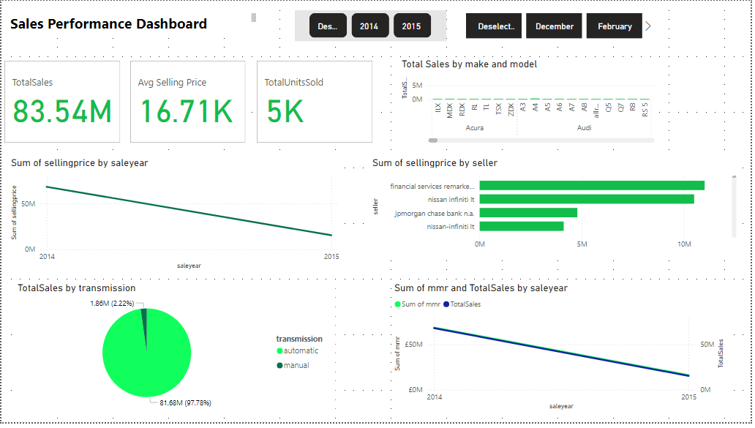

Slide 7
2. Salesperson Performance Dashboard
Components
Top Performers: Highlight top 3-5 salespeople based on total sales.
Sales by Region/Location: (Optional) Map or bar chart showing salesperson performance by region.
Sales by Month: Line chart depicting sales performance of each salesperson over time.
Purpose
This dashboard focuses on evaluating the performance of individual salespeople, allowing management to identify top performers and areas for improvement.

Slide 8
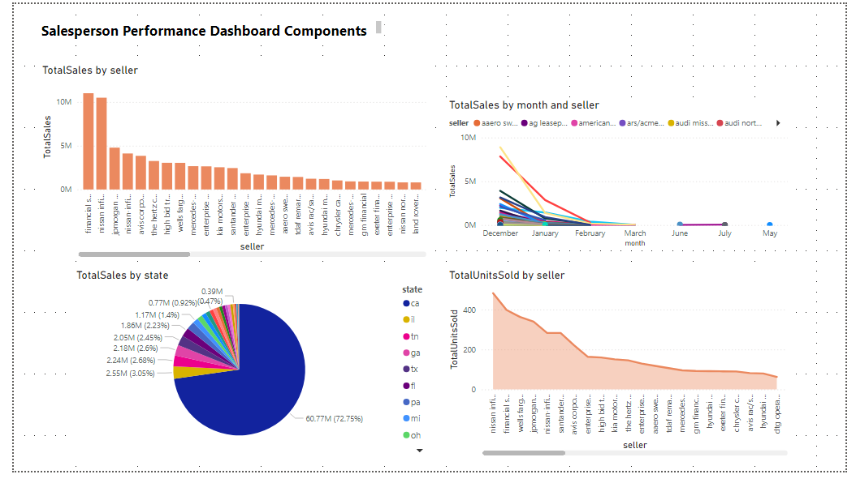

Slide 9
3. Customer Preferences Dashboard
Components
Color Preferences: Bar chart displaying sales by exterior and interior car colors.
Body Type Analysis: dounut chart visualizing sales by car body type (SUV, sedan, etc.).
Trim Level Analysis: Comparison of sales across different trim levels.
Sales by Price Range: Segment sales into different price ranges using a histogram or bar chart.
Purpose
This dashboard analyzes customer preferences, helping the business understand which car features are most popular and guide inventory and marketing decisions.

Slide 10
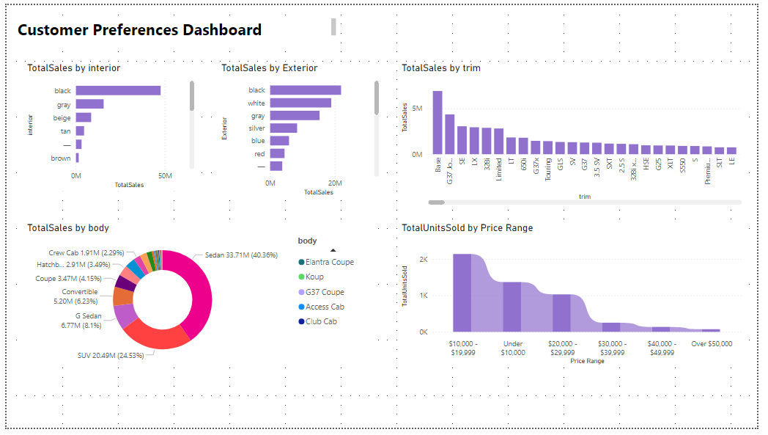

Slide 11
6. Market Trend Dashboard
Components
Year-over-Year Sales Growth: Line chart comparing sales performance year over year.
Sales Forecasting: Time series forecasting to predict future sales based on historical data.
Purpose
This dashboard provides insights into market trends and future sales projections, helping in strategic planning and forecasting.

Slide 12
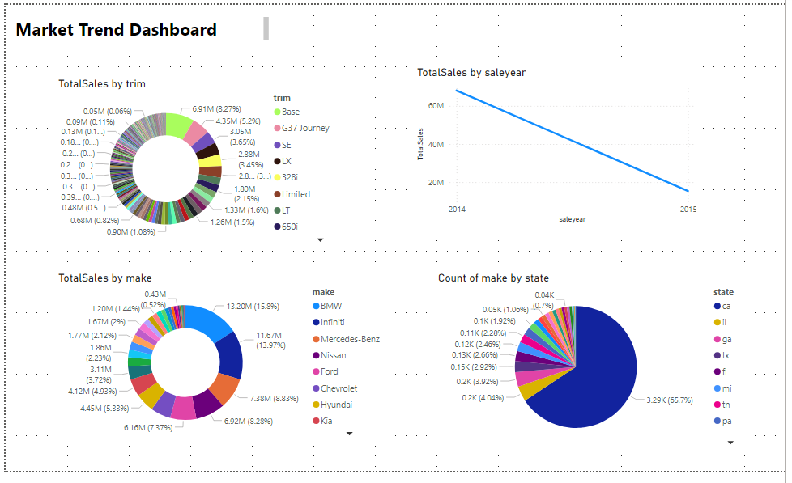

Slide 13
Technical Implementation

Slide 14
Tools Used
Microsoft Power BI Desktop: For creating and designing dashboards.
Power Query Editor: For data cleaning and transformation.
DAX (Data Analysis Expressions): For creating calculated columns and measures.
Power BI Service: For publishing and sharing the dashboards.

Slide 15
Data Preparation
Data Cleaning
Used Power Query Editor to clean the data, handle missing values, and ensure correct data types.
Data Modeling
Established relationships between tables (if multiple tables were used).
Calculated Columns and Measures
Created additional calculated columns and measures using DAX for more detailed analysis.

Slide 16
Dashboard Development Process
Importing Data
Loaded the CSV dataset into Power BI.
Creating Visualizations
Developed the necessary visualizations using a variety of chart types (e.g., bar charts, line charts, KPIs).
Adding Interactivity:
Implemented slicers, filters, and drill-throughs for enhanced interactivity.
Publishing
Published the dashboards to the Power BI Service for sharing and further review.
Testing
Tested the dashboards with different data scenarios to ensure accuracy and functionality.
Formatting and Layout
Customized the look and feel of the dashboards to ensure they are visually appealing and easy to interpret.

Slide 17
Challenges and Solutions
Data Quality Issues: Addressed missing and inconsistent data by performing thorough data cleaning.
Complex Relationships: Simplified complex relationships by creating appropriate data models and measures.
Performance Optimization: Used Power BI performance optimization techniques, such as reducing visual load and optimizing DAX queries.

